Slide 1
The Independence Hall, Pennsylvania, United States of America
Name:
Institution:
Course Code:
Date:

Slide 2
Introduction
UNESCO focus on preserving cultural heritage
It defines it as a product or process that generates wealth to a country
These wealth are inherited from the past
Past generations created them and preserved them for the future
The world contains 1121 properties considered as symbols of cultural heritage
Notes:
Cultural heritage is defined as any product or process that creates wealth for a society or country. Most of these wealth were created in the past by the people who once existed and bestowed them for the good of the future generations. UNESCO considers them as a symbol of wealth creation for different countries across he world. Currently, there exists 1121 cultural heritage properties across the world which has been enabling owners to raise money through domestic and international tourism.

Slide 3
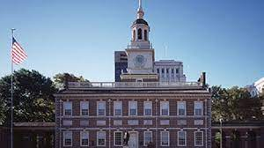
The Independence Hall
The Independence Hall is a world heritage site
It is located in Philadelphia, United States
It was adopted during the US declaration of independence
It symbolizes freedom
https://www.nps.gov/articles/000/independence-hall-world-heritage-site.htm
Notes:
The Independence Hall is one of the global heritage sites located in the United States. It is a symbol of freedom as it was adopted during the late17th century when the country declared its independence in 1776 and later framed its constitution in 1787. It is one of the cultural heritage centers located in North America which does not relate to the Native Americans

Slide 4
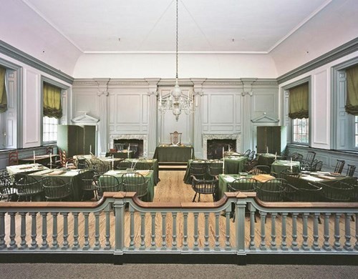
Developing Independence Hall
The hall was designed by Andrew Hamilton and Edmund Woolley
It was developed to host Pennsylvania Colonial Assembly of the commonwealth
It was completed in 1753
It comprised a modest brick structure and a shelter for the liberty bell
The building has undergone different restorations
Notes:
Independence Hall was designed and completed by 1753 by Andrew Hamilton and Edmund Woolley. It was first developed with the aim of hosting Pennsylvania Colonial Assembly of the commonwealth. It was later used as a symbol of national freedom when first adopted during the 1776 declaration of independence and framing of the US constitution. The hall was constructed as a modest brick structure which further served as a housing for the liberty bell (Siamak Seyfi, Michael Hall, Edith Fagnoni. (2019). Since its construction, the building has undergone a series of renovations, including the one in 1950 by the National Park Service with the aim of restoring the building to its original design and structure.

Slide 5
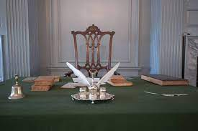
World Heritage Site
The Independence Hall was declared a World Heritage Site in 1979
It became the first US property to be included in UNESCO World Heritage List
It was included as it contains documents that are considered fundamental to the US history
These documents enabled the US become democratic country
The US constitution has influenced other countries towards exercising democracy, thus making the hall a global symbol of freedom.
Notes:
He Independence Hall was considered a World Heritage Site in 1979 considering that it contains important documents that influenced the democracy of the United States and the world. The declaration of Independence and the signing of US constitution are two crucial activities in the US history which as inspired its democracy. Other nations across the world have copied to US system and have successfully embraced democracy in their governance.

Slide 6
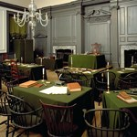
Archeology
It is considered as the birthplace of America
The founding fathers of the country met and debated about the US independence
Also, the US constitution was debated and signed within the building
Therefore, the new America was formed in the Hall
The Assembly Room of the Independence Hall
Notes:
Two key activities took place in the Independence Hall. First, the American founding fathers sat and discussed and signed the declaration of independence. Later, they debated about the US constitution which later signed here (Nicole Porter. (2020) The US framed one of the most supreme constitutions in the world which has been in existence for more than 200 years. The signing of the declaration of independence and the US constitution led to the formation of a new and independent United States of America.

Slide 7
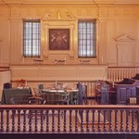
Significance of Independence Hall
The hall was used as a supreme court courtroom
This is located on the first floor of the building
In 1776, militia from Pennsylvania stormed the room and tore down the court of arms
This was after the US declared its independence on the 4th of July
Later, during the Centennial, visitors come here to celebrate the birth of the United States
The Courtroom
Notes:
The British colonies used the Independence Hall as a courtroom, and this was located on the first floor of the building. After the US declared its independence in July 4, 1776, a militia from Pennsylvania stormed the building and tore the court of arms belonging to the Colonial rule. Later, during the Centennial, visitors come here to celebrate the birth of the United States

Slide 8
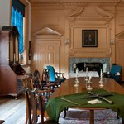
Contin’d
It was later used by the Supreme Executive Council of Pennsylvania to hold meetings in 18th century
Pennsylvania also used it as a US District Court
It was used to try fugitive slaves in 1850s
Currently, it contains a surveyor tool which was used to draw the boundary between Pennsylvania and Maryland
Governor’s Chamber
Notes:
After the signing of the United States Constitution, Independence Hall was later used to accomplish different national functions. First, it was used by the Supreme Executive Council of Pennsylvania to hold meetings in 18th century, and later as US District Court. In 1850s, America used the hall as a trial chamber for fugitive slaves. Apart from viewing the trial and the governors chamber, visitors can also see a surveyor tool within the building which was used to draw the boundary between Pennsylvania and Maryland.

Slide 9
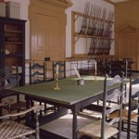
Importance of Independence Hall
It served as a chamber for the Committee of the Assembly
The hall was used to store military goods in 18th century
It was also used as Marshall’s office in 19th century
Above the declaration of independence, accused fugitives were tried
Committee of the Assembly Chamber
Notes:
Also, the Independence Hall hosted the Committee of the Assembly. The military used it to store its goods in 18th century. The hall further hosted the Marshall’s office in 19th century. These were some of the other roles of the Hall after independence which makes it a national treasure and a global heritage site.

Slide 10
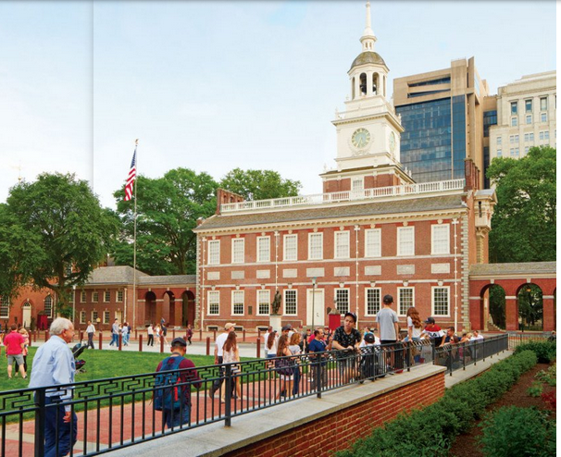
Thoughts about the Hall
Many Americans embrace the hall as a symbol of freedom and national unity
Most of them visit the hall to celebrate the birth of America
Foreigners also visit Pennsylvania to visit the hall
This is a source of revenue to the country
It also boosts study and understanding of the US history
Notes:
Many Americans embrace the hall as a symbol of freedom and national unity. Most of them visit the hall to celebrate the birth of America. Foreigners also visit Pennsylvania to visit the hall. This is a source of revenue to the country. It also boosts study and understanding of the US history.

Slide 11
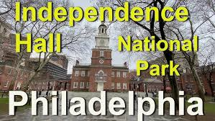
Contin’d
Some believe the impendence hall has received less attention
According to such critics, the hall should be further renovated
The hall receives little attention from the government
Also, tourists visiting the hall receive unfriendly treatment
If this is the case, the problem should be addressed to restore the dignity and the significance of the Independence Hall to the Americans.
Notes:
Many people praise the independence hall and its role as a sign of national and international freedom. However, some believe the impendence hall has received less attention. According to such critics, the hall should be further renovated. The hall receives little attention from the government. Also, tourists visiting the hall receive unfriendly treatment. If this is the case, the problem should be addressed to restore the dignity and the significance of the Independence Hall to the Americans (Martin Thomas Falk, Eva Hagsten. (2021)

Slide 12
Reference
https://www.nps.gov/articles/000/independence-hall-world-heritage-site.htm
Martin Thomas Falk, Eva Hagsten. (2021) Visitor flows to World Heritage Sites in the era of Instagram. Journal
Nicole Porter. (2020) Strategic planning and place branding in a World Heritage cultural landscape: a case study of the English Lake District, UK. European Planning Studies 28:7, pages 1291-1314.
Siamak Seyfi, C. Michael Hall, Edith Fagnoni. (2019) Managing World Heritage Site stakeholders: a grounded theory paradigm model approach. Journal of Heritage Tourism 14:4, pages 308-324.

